Slide 1
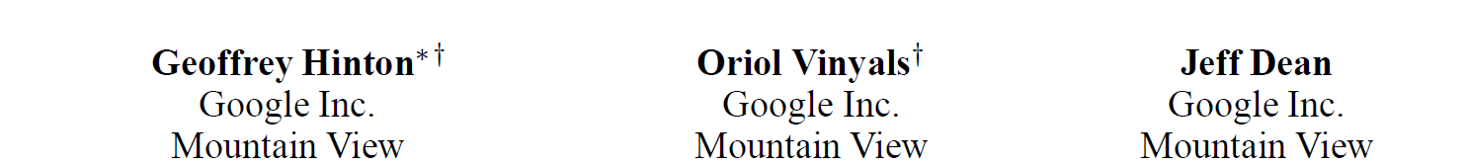
Distilling the Knowledge in a Neural Network https://arxiv.org/abs/1503.02531 NIPS
陈浩然
2019.7.15

Slide 2
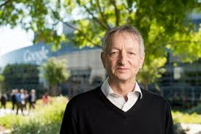
http://www.cs.toronto.edu/~hinton/
Geoffrey Hinton：
Department of Computer Science University of Toronto
Tuning award
………………………………
母亲是数学老师
父亲是昆虫学家
舅舅是经济学家(GDP)
高曾祖父(逻辑学家George Boole)

Slide 3
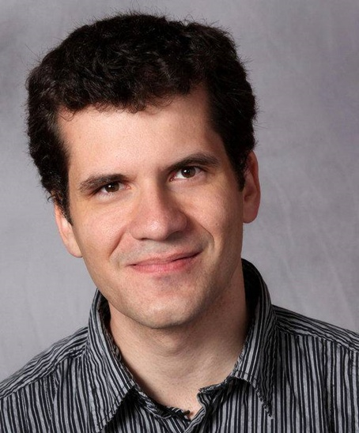
http://www1.icsi.berkeley.edu/~vinyals/
A Research Scientist at the Google Brain
A PhD student in the Electrical Engineering & Computer Science department at the University of California, Berkeley. I currently work on interdisciplinary topics including Speech Recognition and Signal Processing under Nelson Morgan's supervision, TeleImmersive technologies with Ruzena Bajcsy, and Computer Vision and Machine Learning with Trevor Darrell. I am a recipient of the 2011 Microsoft Research PhD Fellowship.
I have recently become involved with the Berkeley Overmind, a project to build an AI that plays a popular real time strategy game.
I graduated in September 2009 with a master's degree (MSc) in Computer Science and Engineering from the University of California, San Diego, and in 2007 I completed a dual degree in Telecommunication Engineering and Mathematics from the Polytechnic University of Catalonia in Barcelona, Spain. I did my undergrad thesis at the Robotics Institute of the Carnegie Mellon University on Machine Learning and Computer Vision. In addition, I got to work with a fabulous group of people during three summer internships at Microsoft Research in Redmond, WA, and at Google Research in Mountain View, CA
Oriol Vinyals

Slide 4
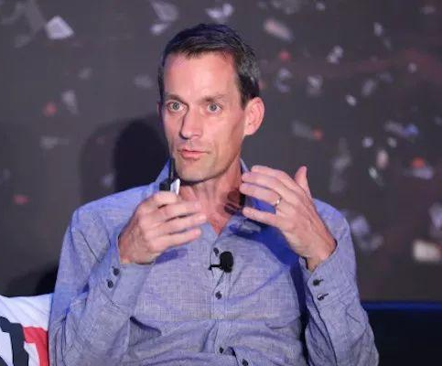
Jeff Dean
The lead of Google.ai.
美国工程院院士
华盛顿大学博士
ACM、AAAS fellow
Google Brain
Google 20号员工
“Jeff Dean 提交代码前会编译和运行他的代码，只是为了检验编译器和链接器有没有问题。”
“Jdff Dean”的键盘只有0和1

Slide 5
The conflicting constraints of learning and using
The easiest way to extract a lot of knowledge from the training data is to learn many different models in parallel.
We want to make the models as different as possible to minimize the correlations between their errors.
We can use different initializations or different architectures or different subsets of the training data.
It is helpful to over-fit the individual models.
A test time we average the predictions of all the models or of a selected subset of good models that make different errors.
That’s how almost all ML competitions are won (e.g. Netflix)

Slide 6
Why ensembles are bad at test time
A big ensemble is highly redundant. It has very very little knowledge per parameter.
At test time we want to minimize the amount of computation and the memory footprint.
– These constraints are generally much more severe at test time than during training.

Slide 7
Problem:
Too cumbersome to Deploy to the client
Overfitting
Solution :
Distilling the Knowledge in a Neural Network

Slide 8
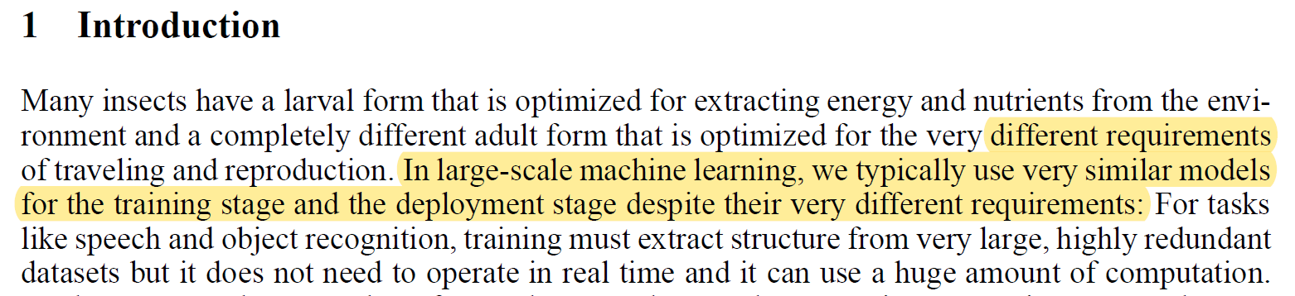
昆虫记 :“蝴蝶以毛毛虫的形式吃树叶积攒能量逐渐成长，最后变换成蝴蝶这一终极形态来完成繁殖。”
虽然是同一个个体，但是在面对不同环境以及不同任务时，个体的形态却是非常不同。毛毛虫的形态是为了更方便的吃树叶，积攒能量，但是为了增大活动范围提高繁殖几率，毛毛虫要变成蝴蝶来完成这样的繁殖任务。
蒸馏神经网络，其本质上就是要完成一个从毛毛虫到蝴蝶的转变。因为在使用神经网络时，训练时候的模型和实际应用的模型往往是相同的，就好像一直是一个毛毛虫，既做了吃树叶积累能量的事情，又去做繁殖这项任务，既臃肿又效率低下。所以使用同样形态的模型，一方面会导致模型不能针对特定性的任务来快速学习，另一方面实际应用中如果也是用训练时非常庞大的模型会造成使用开销负担过重。

Slide 9








An analogy
butterfly
small production model
caterpillar
big ensemble of learned models
leaves
training data

Slide 10
The main idea
The ensemble implements a function from input to output. Forget the models in the ensemble and the way they are parameterized and focus on the function.
After learning the ensemble, we have our hands on the function.
Can we transfer the knowledge in the function into a single smaller model?
Caruana et. al. 2006 had the same idea but used a different way of transferring the knowledge.

Slide 11
Distillation
Matching soft targets and hard target
softmax
Distillation
······
······
Input
The cumbersome model
The distilled model

Slide 12
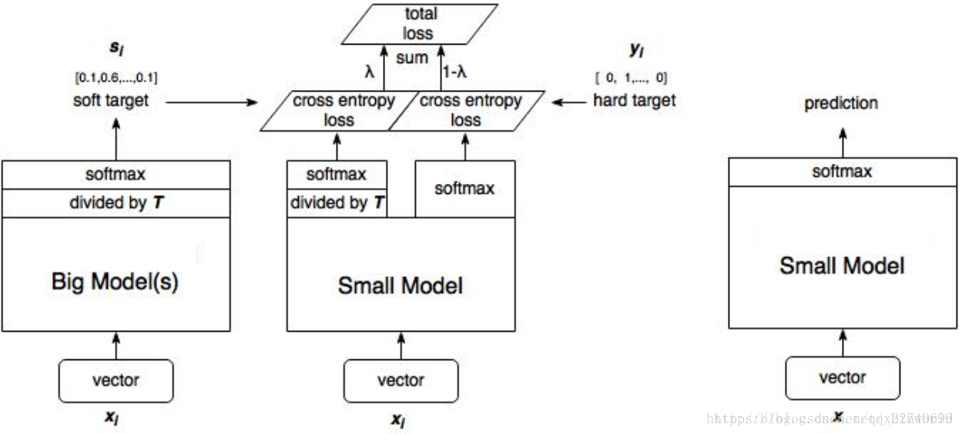

Slide 13
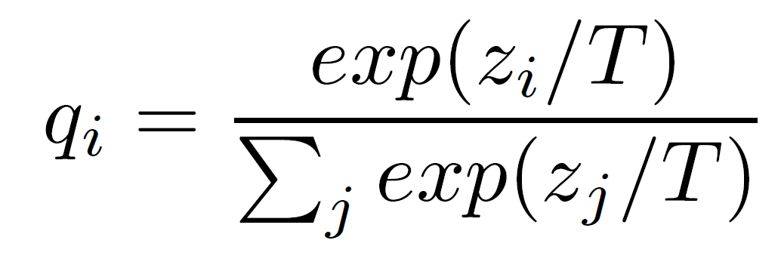
Soft targets: A way to transfer the function
If the output is a big N-way softmax, the targets are usually a single 1 and a whole lot of 0’s.
– little information
If we have the ensemble, we can divide the averaged logits from the ensemble by a “temperature” to get a much softer distribution.
This reveals much more information about the function on each training case.

Slide 14
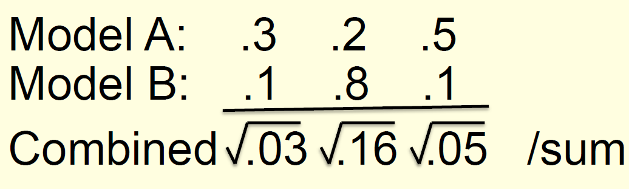
An aside: Two ways to average models
We can combine models by averaging their output probabilities:
class 1
class 2
class 3
Model A: Model B:
.3 .2 .5
.1 .8 .1
.5 .3
Combined .2
We can combine models by taking the geometric means of their output probabilities:

Slide 15
An example of hard and soft targets
cow | dog | cat | car
0 | 1 | 0 | 0
cow | dog | cat | car
original hard targets
output of geometric ensemble
₁₀−6
.9
.1
₁₀−9
Problem：not soft enough
cow dog cat car
softened output of ensemble
.05 .3 .2 .005
Softened outputs reveal the dark knowledge in the ensemble.

Slide 16
Adding in the true targets
If we just train the final model on the soft targets from the ensemble, we do quite well.
We learn fast because each training case imposes much more constraint on the parameters than a single hard target.
But it works better to fit both the hard targets and the soft targets from the ensemble.

Slide 17
Experiment on MNIST
Vanilla backprop in a 784 -> 800 -> 800 -> 10 net with rectified linear hidden units gives 146 test errors.
RELU: y = max(0, x)
If we train a 784 -> 1200 -> 1200 -> 10 net using dropout and weight constraints and jittering the input, we eventually get 67 errors.
How much of this improvement can be transferred to the 784 -> 800 -> 800 -> 10 net?

Slide 18
Transfer to the small net
Using both the soft targets obtained from the big net and the hard targets, we get 74 errors in the 784 -> 800 -> 800 -> 10 net.
The transfer training uses the same training set but with no dropout and no jitter.
Its just vanilla backprop (with added soft targets).
The soft targets contain almost all the knowledge.
The big net learns a similarity metric for the training digits even though this isn’t the objective function for learning.

Slide 19
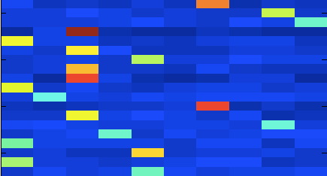



The soft outputs
(one row per training case)
0 1 2 3 4 5 6 7 8 9
this 2 resembles a 1 and nothing much else
this 2 resembles
0, 3, 7, 8
this 2 resembles
4 and 7

Slide 20
A very surprising result on MNIST
Train the 784 -> 800 -> 800 -> 10 net on a transfer set that does not contain any examples of a 3. After this training, raise the bias of the 3 by the right amount.
– The distilled net then gets 98.6% of the test threes correct even though it never saw any threes during the transfer training.

Slide 21
An even more surprising result on MNIST
Train the 784 -> 800 -> 800 -> 10 net on a transfer set that only contains images of 7 and 8.
After training, lower the biases of 7 and 8 by the optimal amount.
The net then gets 87% correct over all classes.

Slide 22
Conclusion so far
It is well known that object recognition is greatly improved by transforming the input images in ways that do not change the label.
But this brute-force method means we need to train on a lot more images.
Transforming the targets has similarly big effects on generalization.
This does not change the size of the training set.
But you have to get the soft targets from somewhere.

Slide 23
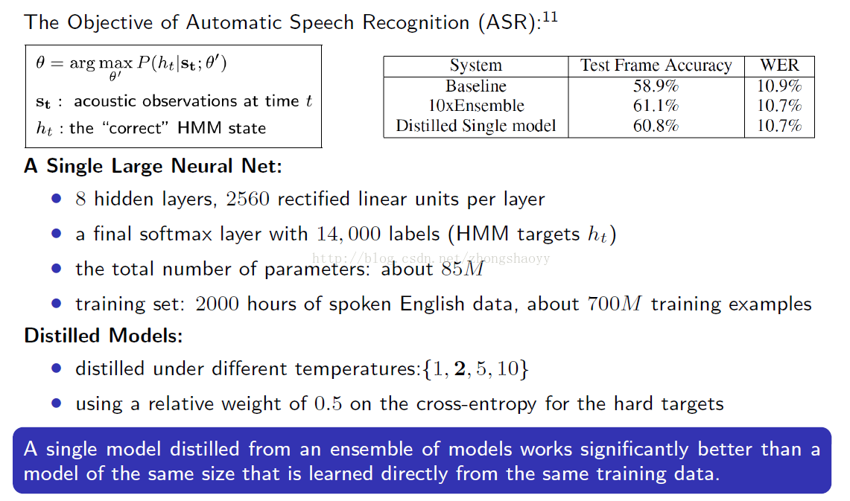
4. Experiments on speech recognition

Slide 24
Conclusion
Soft targets area a VERY good regularizer.
They prevent the model from being too sure.
They allow each training case to impose much more constraint on the weights.

Slide 25
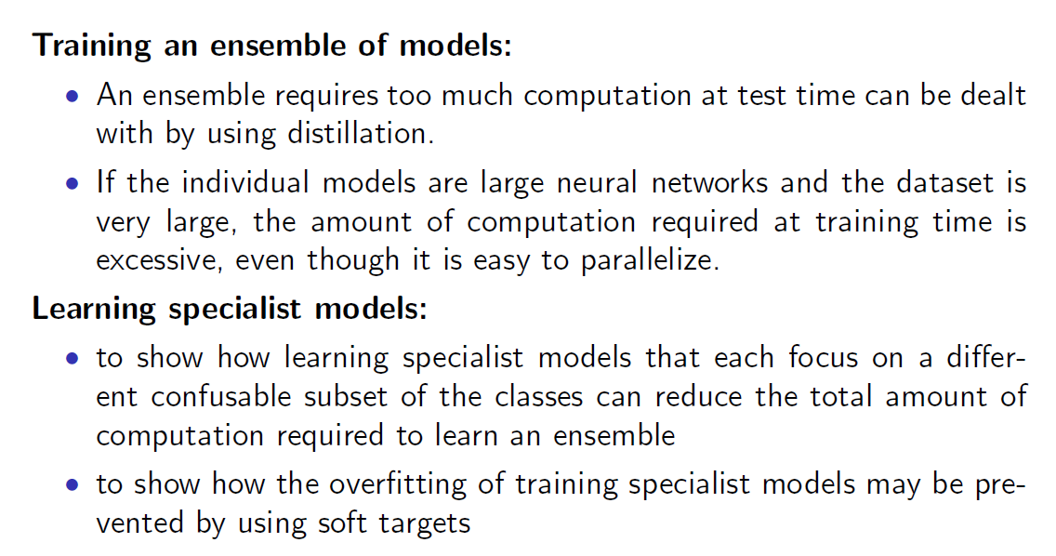
5.Training ensembles of specialists on very big datasets

Slide 26
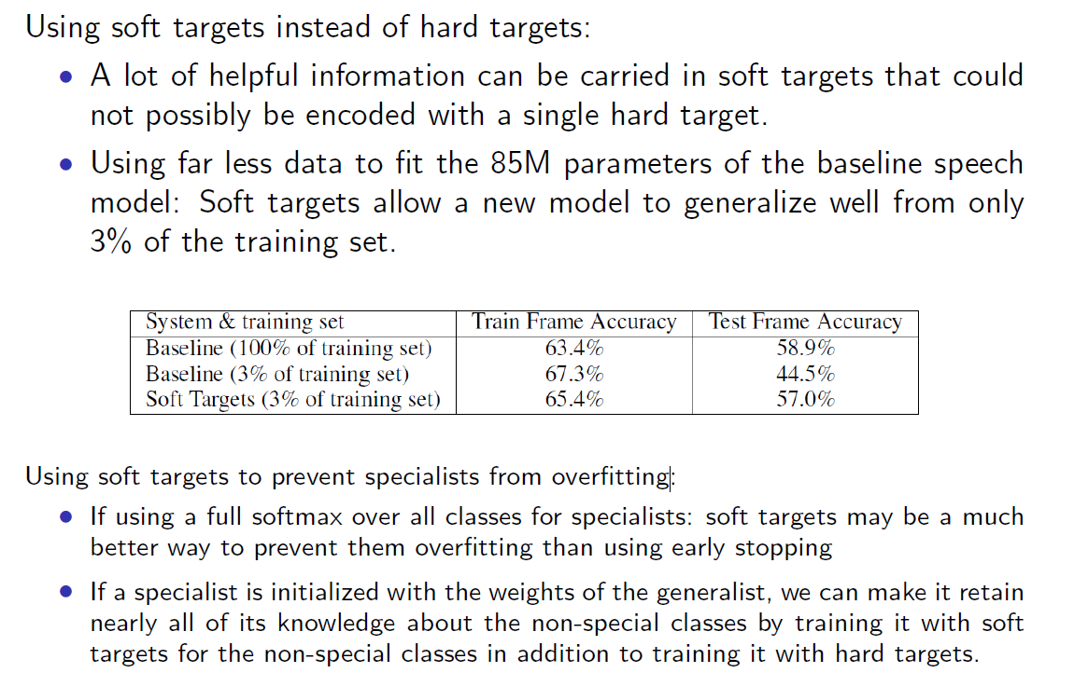

Slide 27
Problem:
Too cumbersome to Deploy to the client
Overfitting
Solution :
Distilling the Knowledge in a Neural Network

Slide 28
Inspection
一个网络的表达能力与什么有关？
对于目前的一些问题，浅层网络表现的不好，是由于表达能力欠缺，还是因为优化算法更加适合浅层？

Slide 29
THE END
THE END

